Slide 1
WELCOME TO
SIMRAN FLOWTECH INDUSTRIES

Slide 3
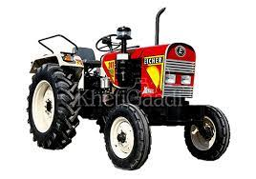
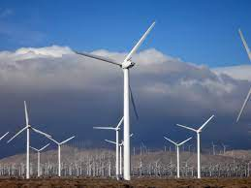
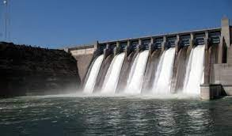
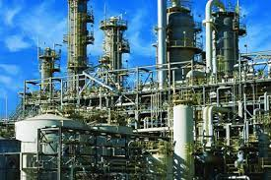
PROMOTOR PROFESSIONAL JOURNEY SO FAR
Gurmeet Singh Virdi
MECHANICAL ENG. 1990, PGDM Business Management
1990-1995 Eicher Tractors
1995-1996 Flovel Tacke
1996-2002 Andritz Hydro
2002-2004 Process Plant Equipment
SIMRAN FLOWTECH INDUSTRIES

Slide 4
SIMRAN FLOWTECH INDUSTRIES “Making your Machines Perform Better”
Plant Information
Established : 2004
Location : Faridabad
Activity : Manufacturing
Total Staff : 50-Nos
Certification : ISO:9001- 2015
Member : NSIC
: FICCI
Shop floor Area : 15600 Sq. feet

Slide 5
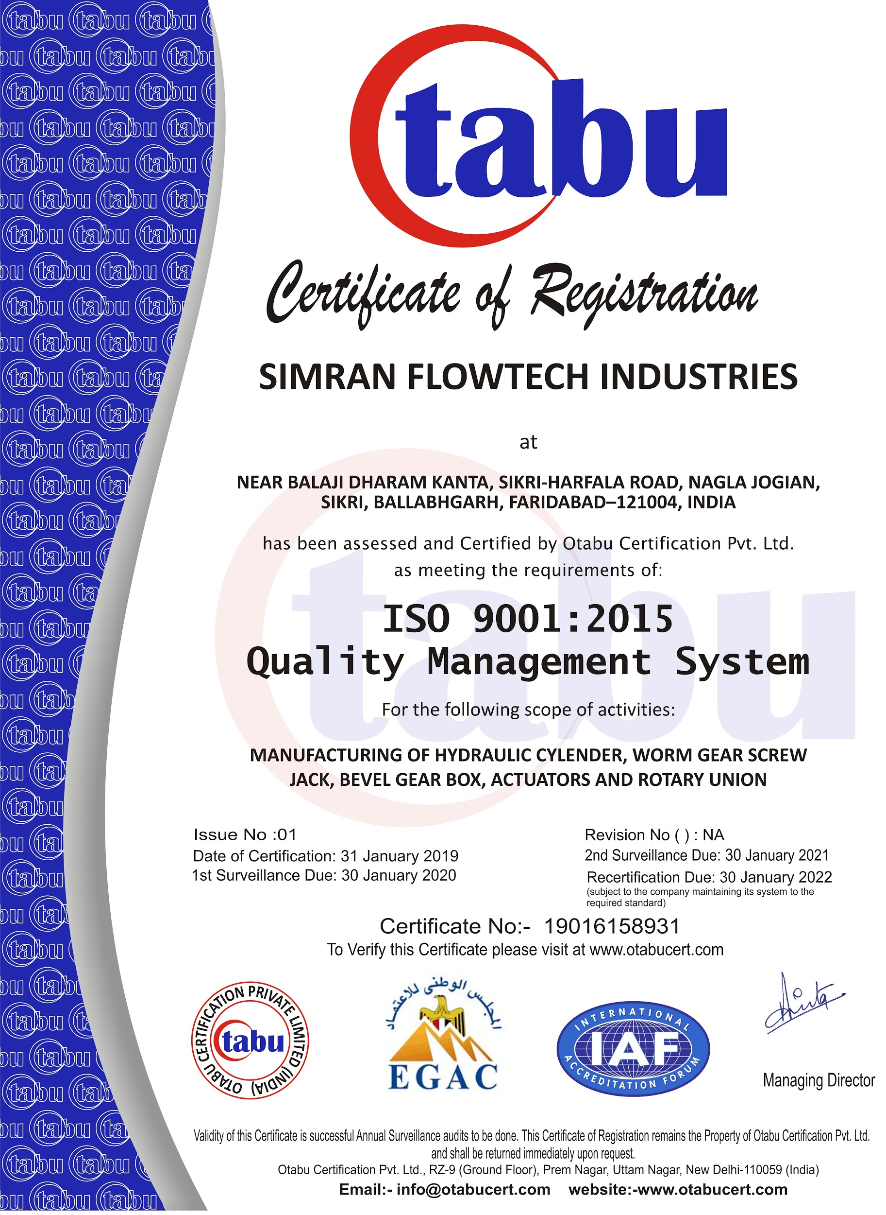
Quality Certification
SIMRAN FLOWTECH INDUSTRIES “Making your Machines Perform Better”
MEMBERSHIPS:
CII
SIDM
NSIC
FIA
ISO 9001:2015 Certificate
Udyam/ MSME Certificate

Slide 6
INDUSTRIES SERVED
Defense
Hydro Power Plant Equipment Manufacturers
Cold Rolling Mill Equipment Manufacturers
Tube Mill Equipment Manufacturers
Glass Manufacturing Industry
Paper Mills
SPM Manufacturers
Earth Moving Equipment Manufacturers
Pollution Treatment Plant Manufacturers
General Heavy / Medium Eng. Industry
And many more…..

Slide 7
SIMRAN FLOWTECH INDUSTRIES “Making your Machines Perform Better”
OUR TEAM

Slide 8
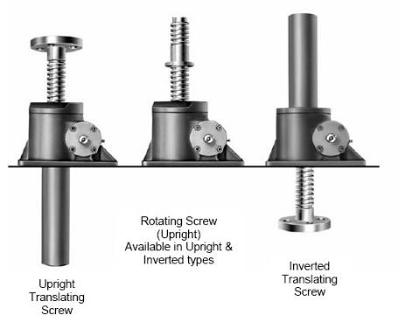
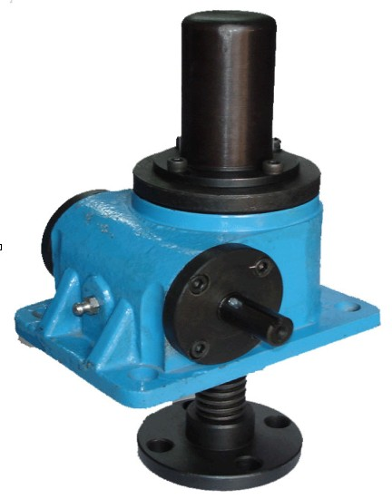
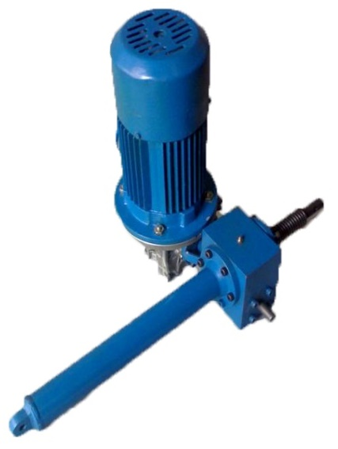
WORM GEAR SCREW JACKS
SIMRAN FLOWTECH INDUSTRIES “Making your Machines Perform Better”
RANGE : 0.5 – 150 TONS
STURDY DESIGN, LONG LIFE, EXCELLENT PERFORMANCE.
DIFFERENT MATERIAL COMBINATIONS AVAILABLE ACCORDING TO APPLICATION
APPLICATIONS: HYDRO DAM GATES, MACHINE TOOLS, TUBE MILLS, ROLLING MILLS, CEMENT PLANTS ETC.

Slide 9
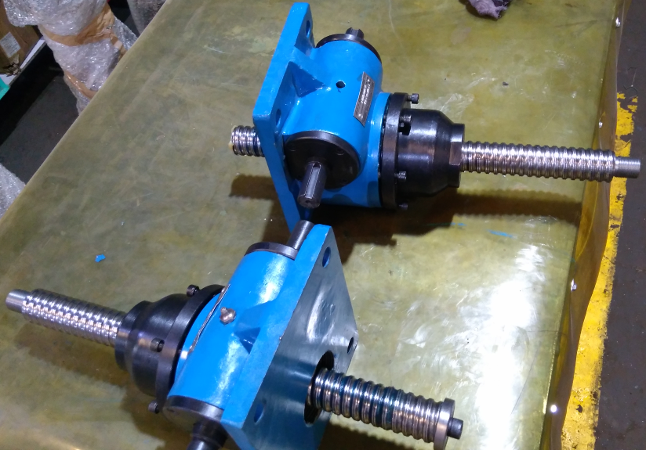
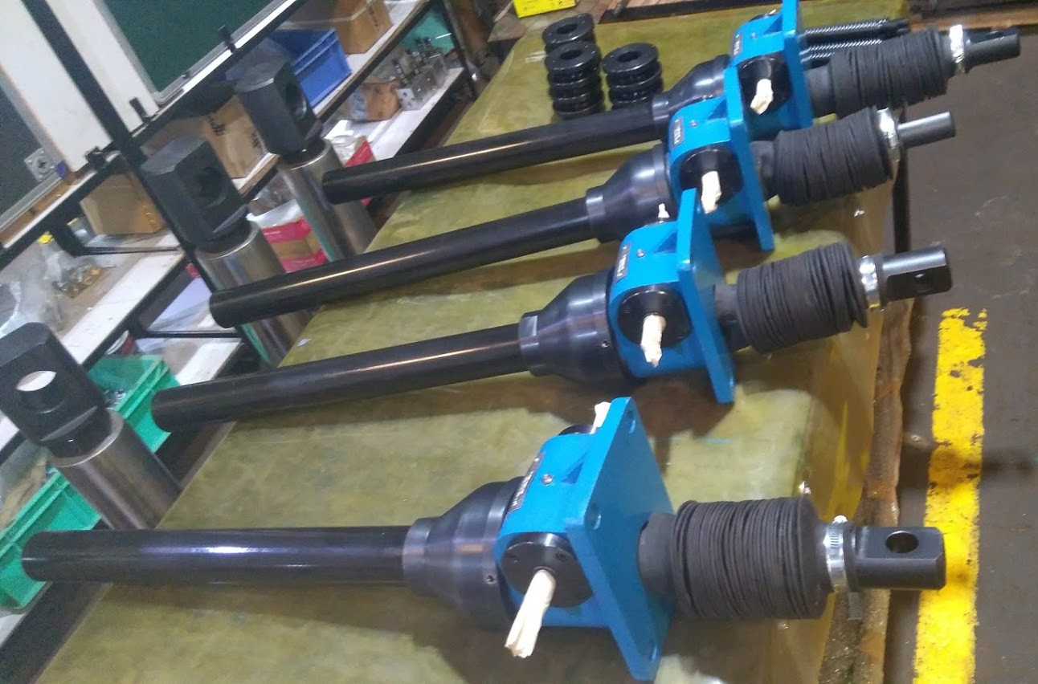
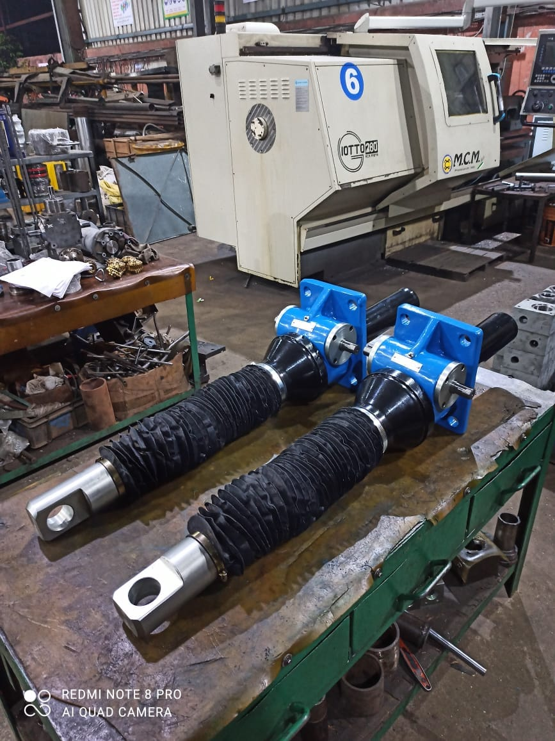
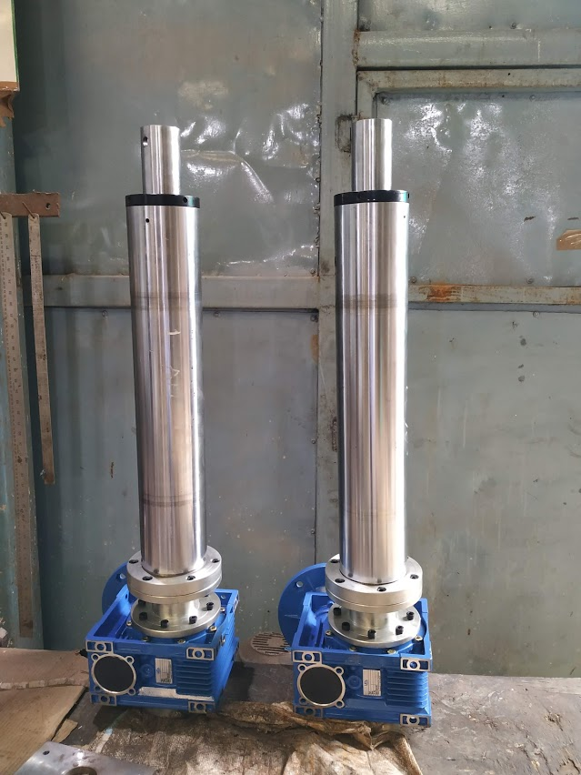
WORM GEAR BALL SCREW JACKS
SIMRAN FLOWTECH INDUSTRIES “Making your Machines Perform Better”
RANGE : 0.5 – 150 TONS
STURDY DESIGN, LONG LIFE, EXCELLENT PERFORMANCE.
DIFFERENT MATERIAL COMBINATIONS AVAILABLE ACCORDING TO APPLICATION
APPLICATIONS: HYDRO DAM GATES, MACHINE TOOLS, TUBE MILLS, ROLLING MILLS, CEMENT PLANTS ETC.
2.5 Ton Ball Screw Actuator
5 Ton Ball Screw Jacks
25 Ton Ball Screw Jacks

Slide 10
LINEAR ACTUATORS / ELECTRIC CYLINDERS
SIMRAN FLOWTECH INDUSTRIES “Making your Machines Perform Better”
RANGE : 0.5 – 50 TONS
STURDY DESIGN, LONG LIFE, EXCELLENT PERFORMANCE.
DIFFERENT MATERIAL COMBINATIONS AVAILABLE ACCORDING TO APPLICATION
APPLICATIONS: HYDRO DAM GATES, MACHINE TOOLS, TUBE MILLS, ROLLING MILLS, CEMENT PLANTS ETC.
2.5 Ton Linear Actuator
5 Ton Linear Actuators
Bevel Gear Linear Actuator

Slide 11
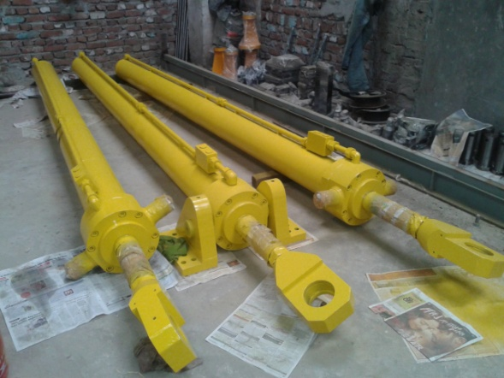
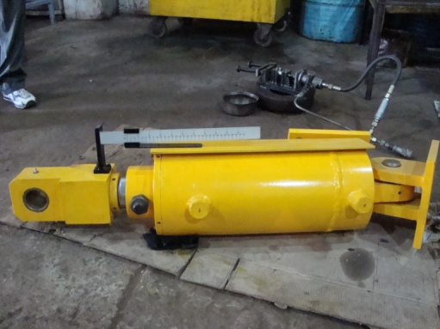
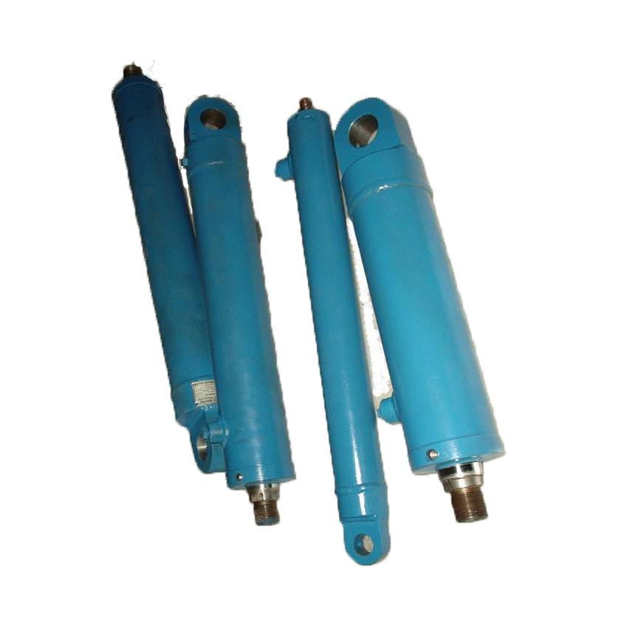
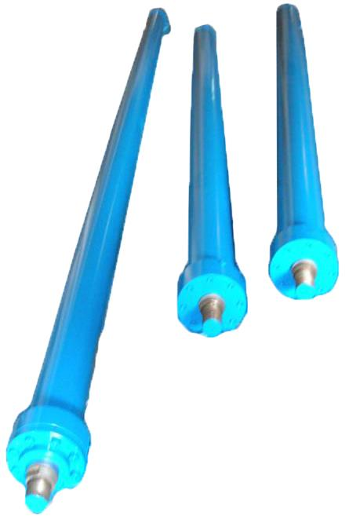
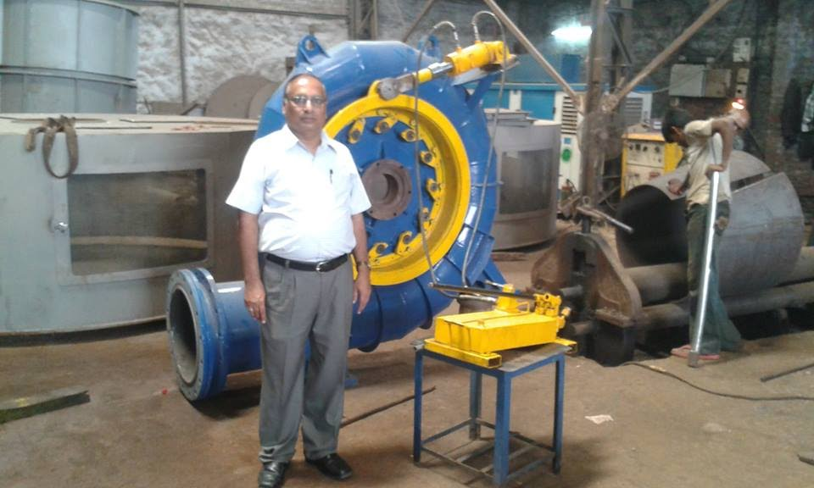
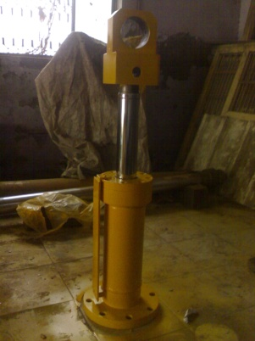
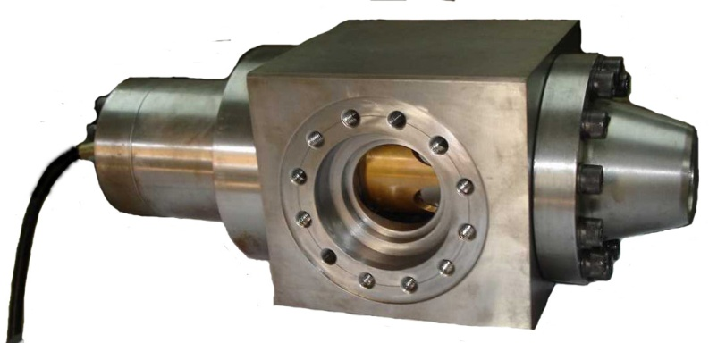
HYDRAULIC CYLINDERS/SERVOMOTORS
RANGE : D12 – D500 Dia Bore, Max 5000 mm stroke manufactured
3D VALIDATION OF DESIGNS
IMPORTED TUBES, RODS AND SEALS ENSURING LONG TROUBLE-FREE PERFORMANCE.
STANDARD (ISO) AS WELL AS CUSTOM DESIGNS
APPLICATIONS: MACHINE TOOLS, HYDROPOWER PROJECTS, TUBE MILLS, ROLLING MILLS, CEMENT PLANTS ETC
Radial Gate Servo Motors for Karikyam Project
Guide Vane Servo Motors for Taiwan Project
Guide Vane Servo Motors for Rukti Project
Guide Vane Servo Motors for Vrindavan Project

Slide 12
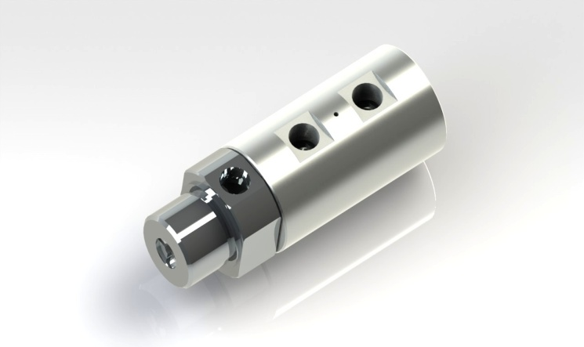
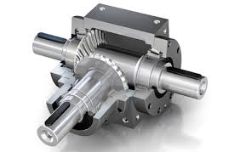
PRODUCT RANGE
Hydraulic Rotary Unions or Oil Heads Size : 1” to 1.5” BSP APPLICATION : Hydro Power Plants, TUBE MILLS, PAPER MILLS, STEEL ROLLING MILLS ETC.
Bevel Gear Boxes Size : Size BG20 to BG55 APPLICATION : Hydro Power Plants, TUBE MILLS, PAPER MILLS, STEEL ROLLING MILLS ETC.

Slide 13
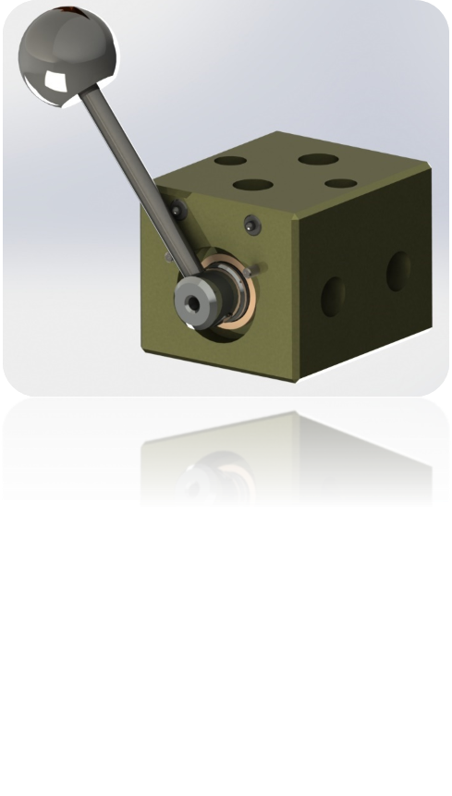
REGULAR PRODUCTION JCB
3 Way Valve APPLICATION : JCB Power Projects P Ltd, For Fuel Source Changing
Drain Valve Assembly Size : 3 Models, Compact, Mid and High Range APPLICATION : JCB Generator

Slide 14
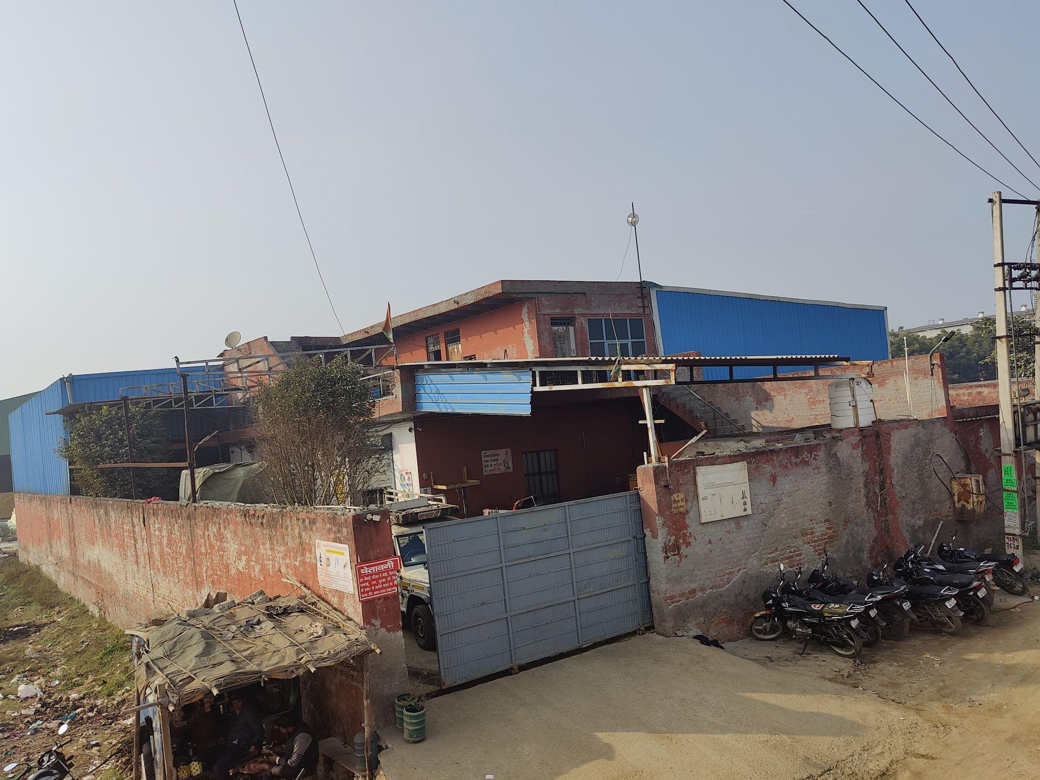
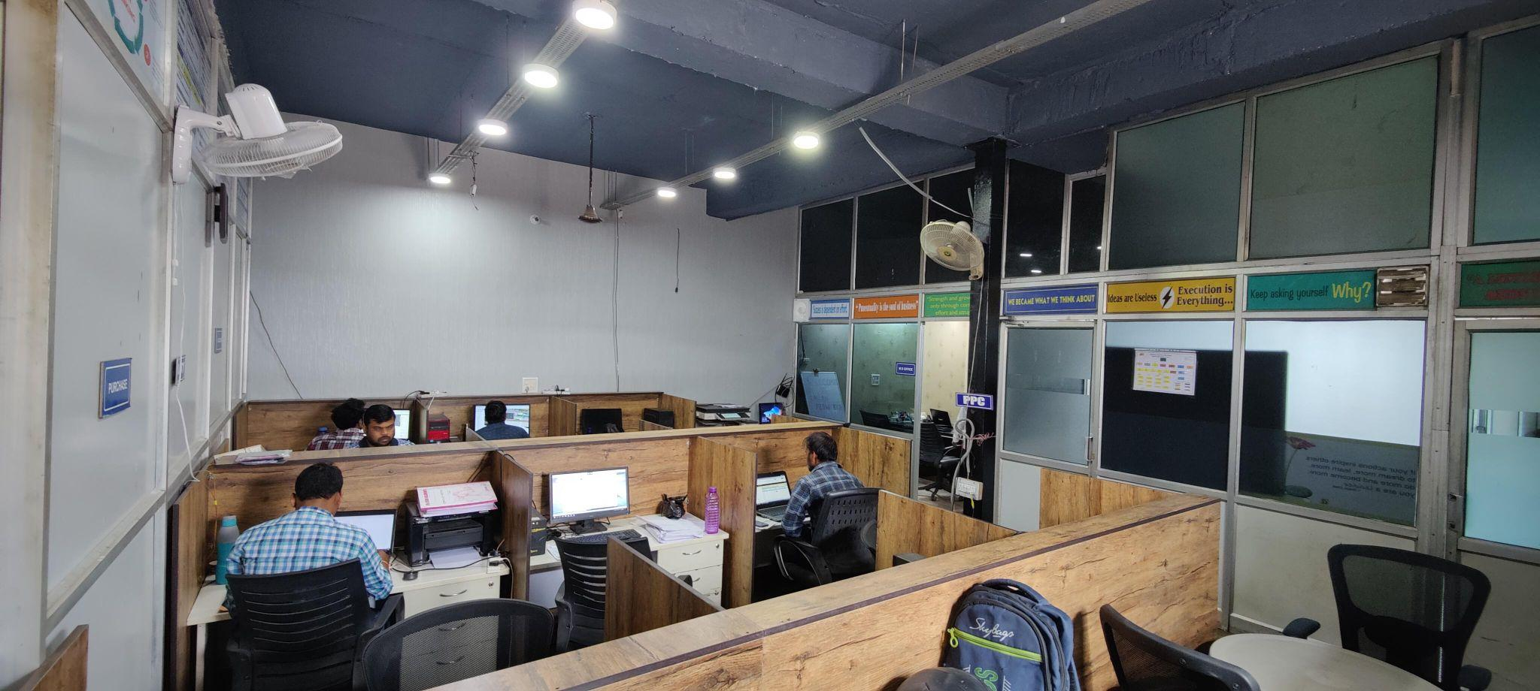
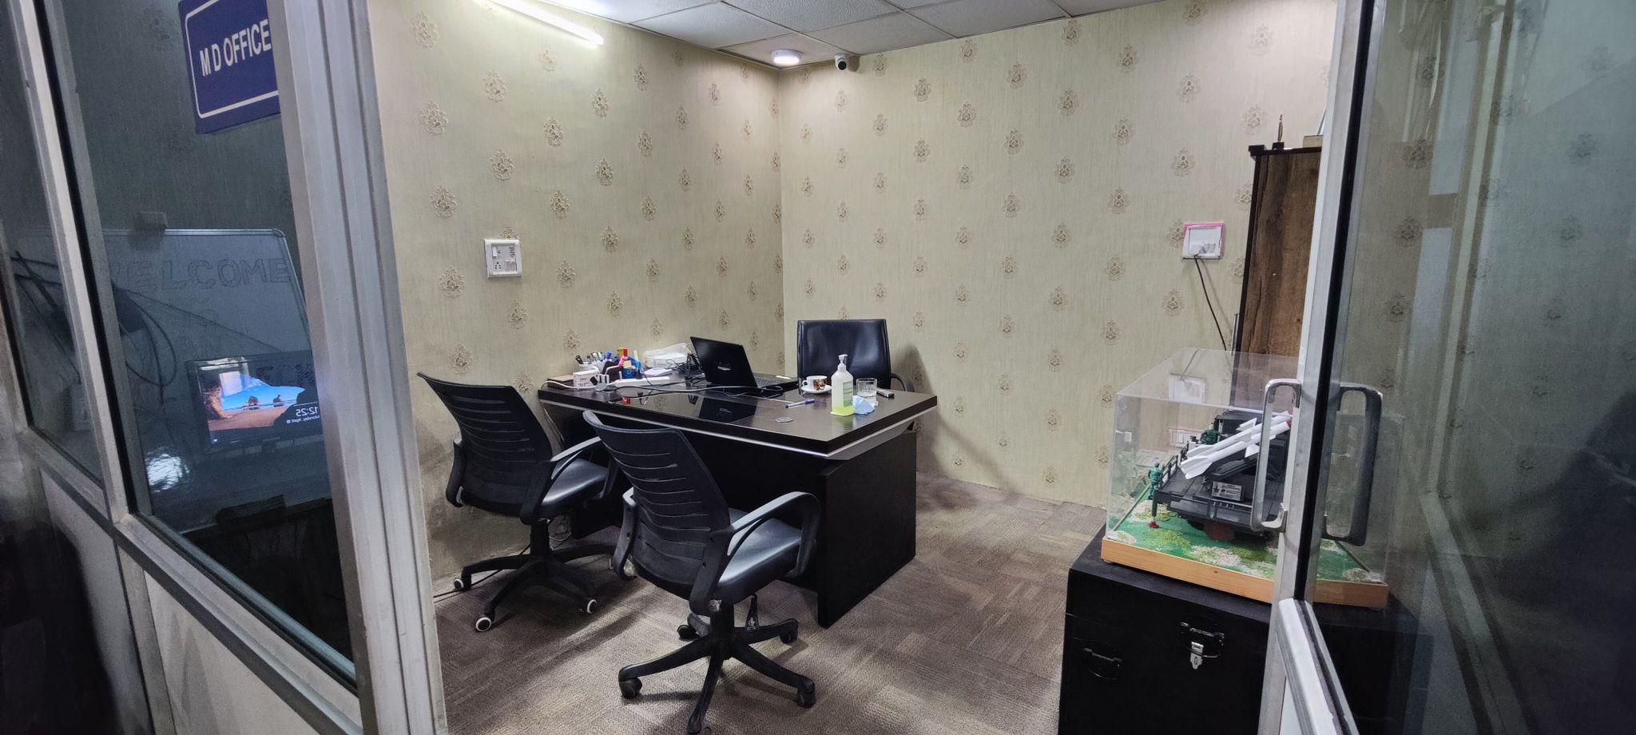
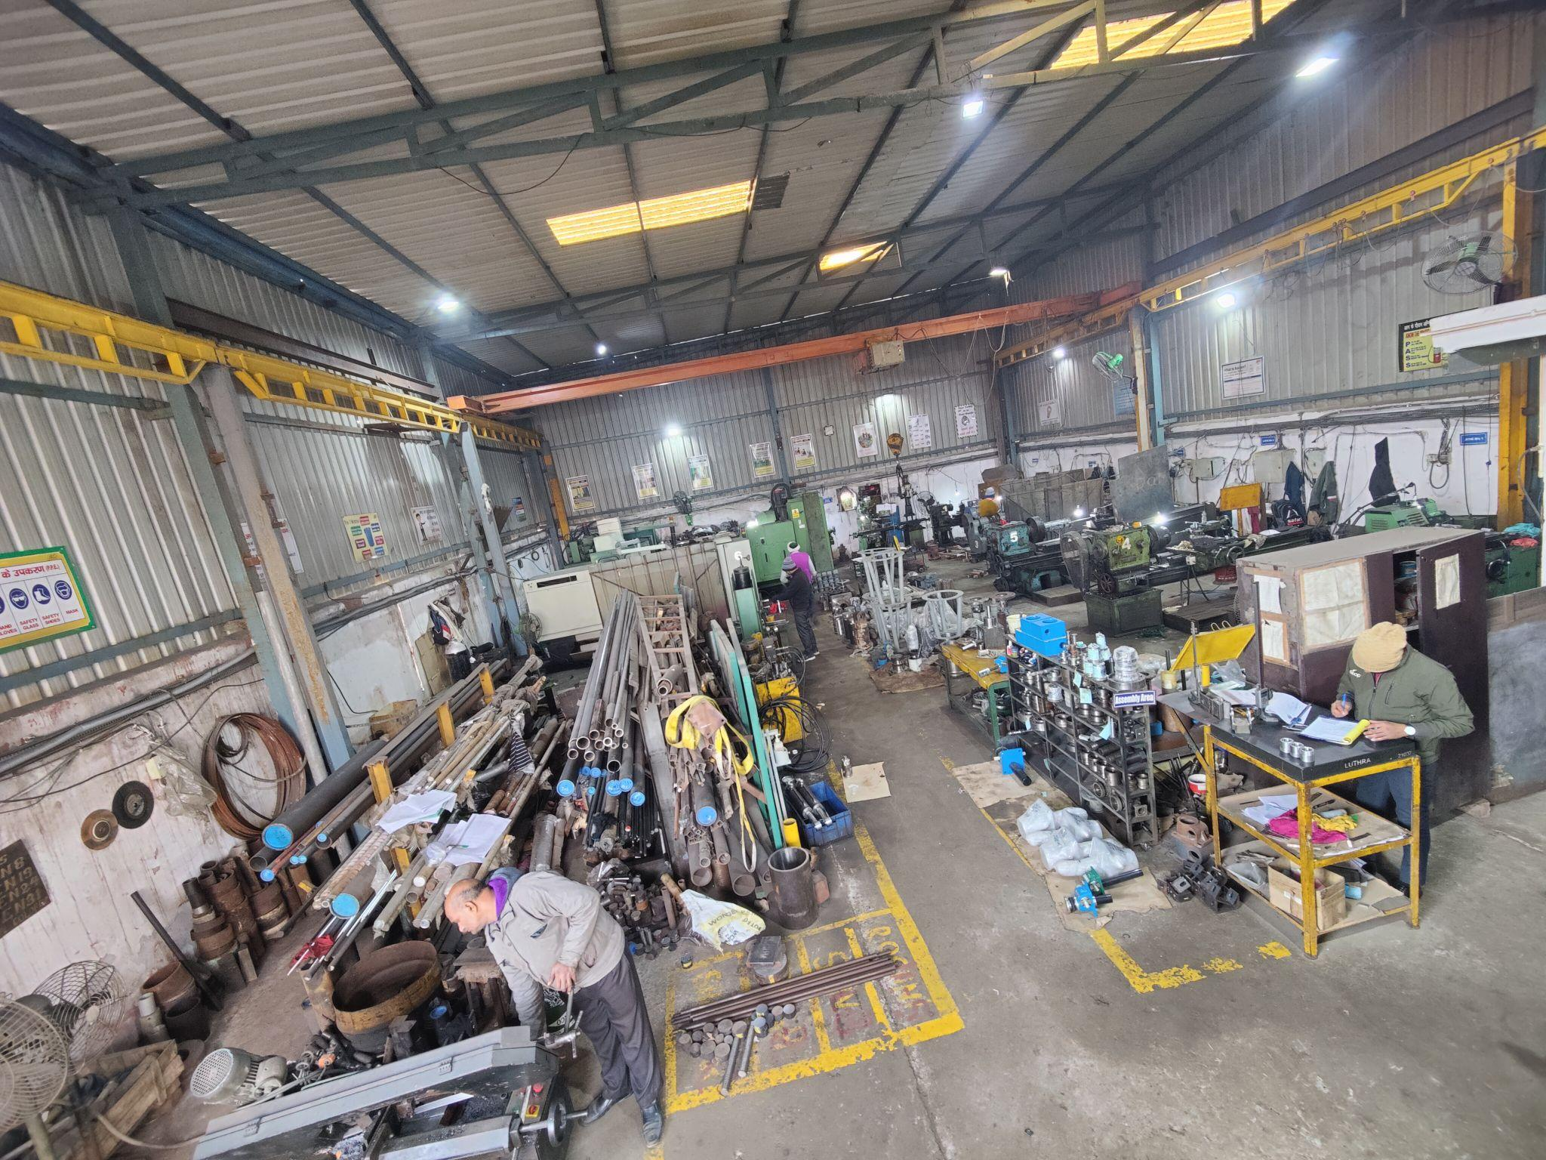
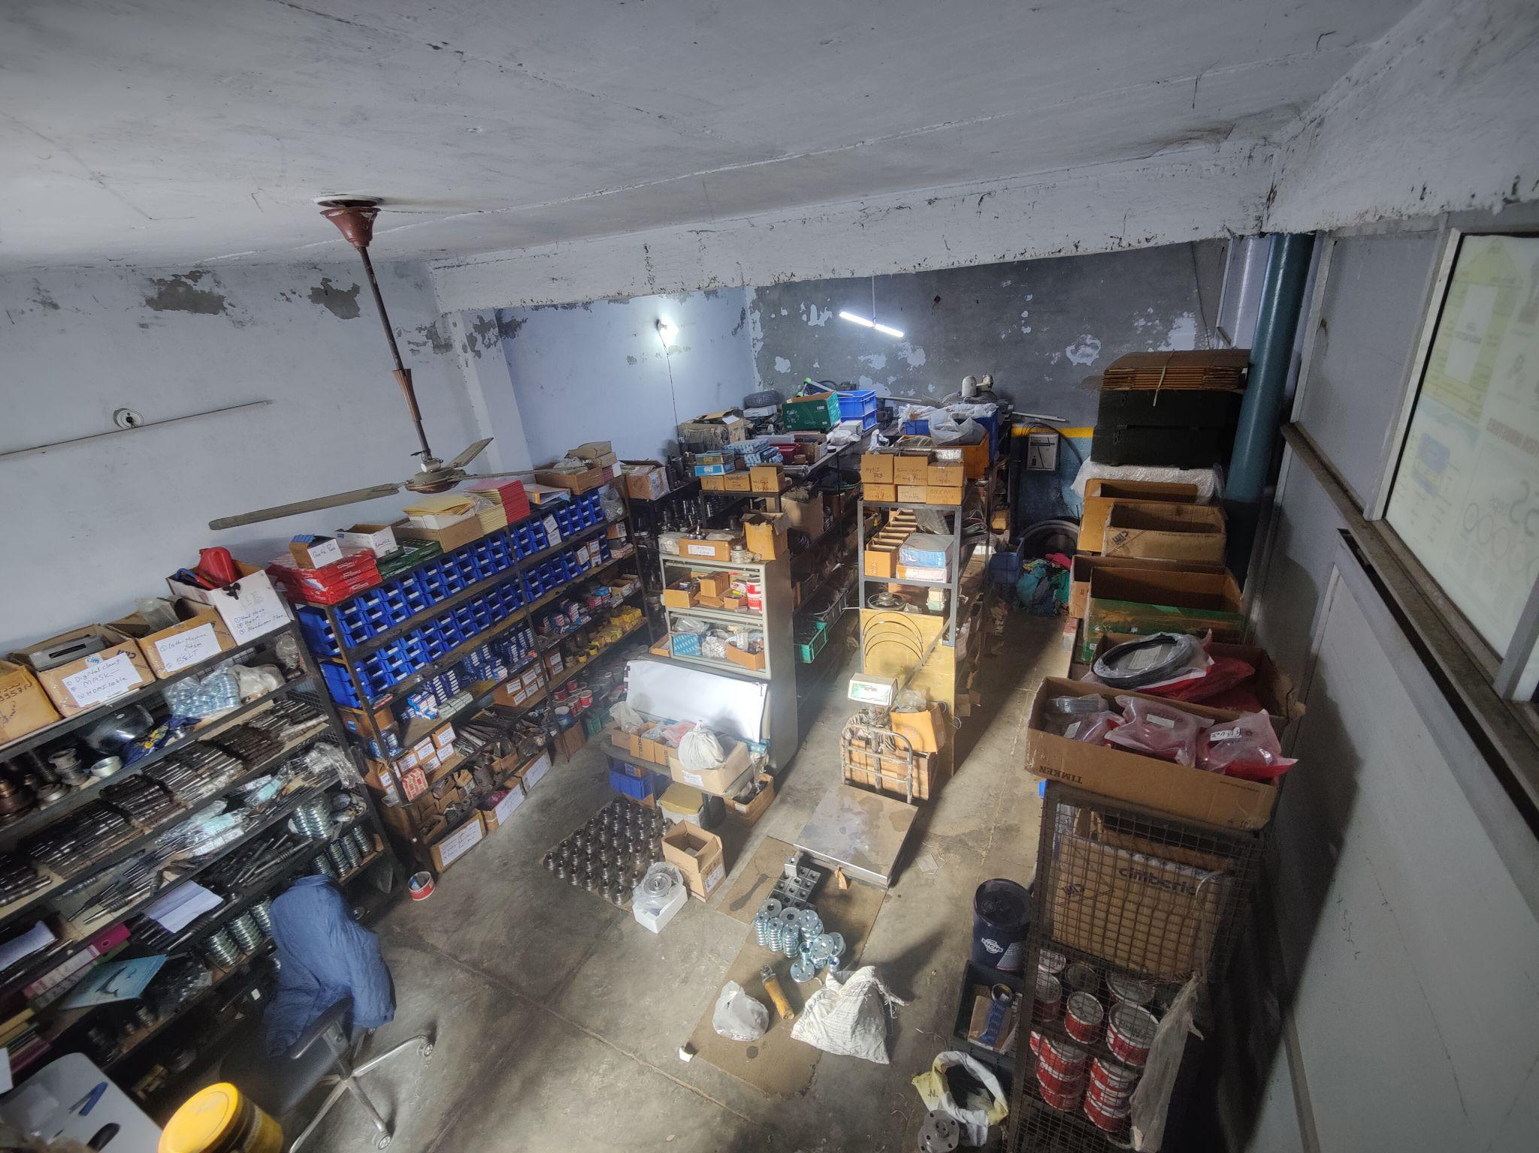
OVERVIEW OF OUR FACILITIES
Factory Overview
Office
Plant-1
Store
Plant-2

Slide 15
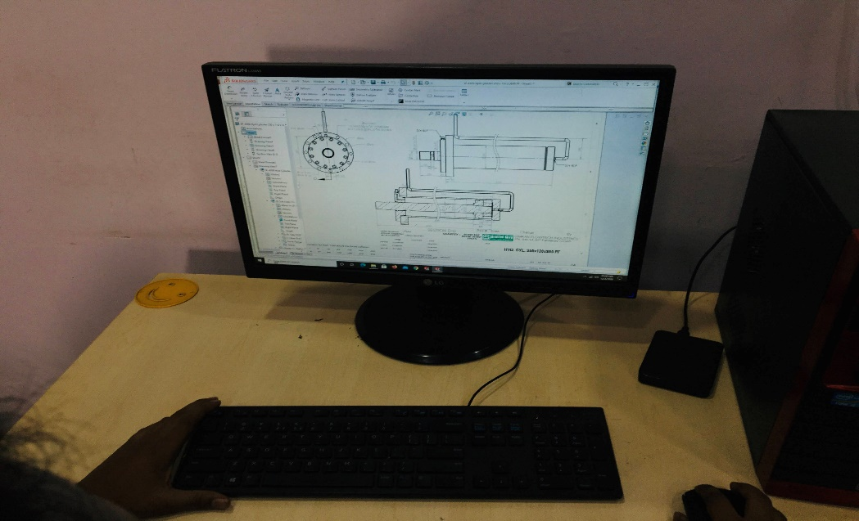
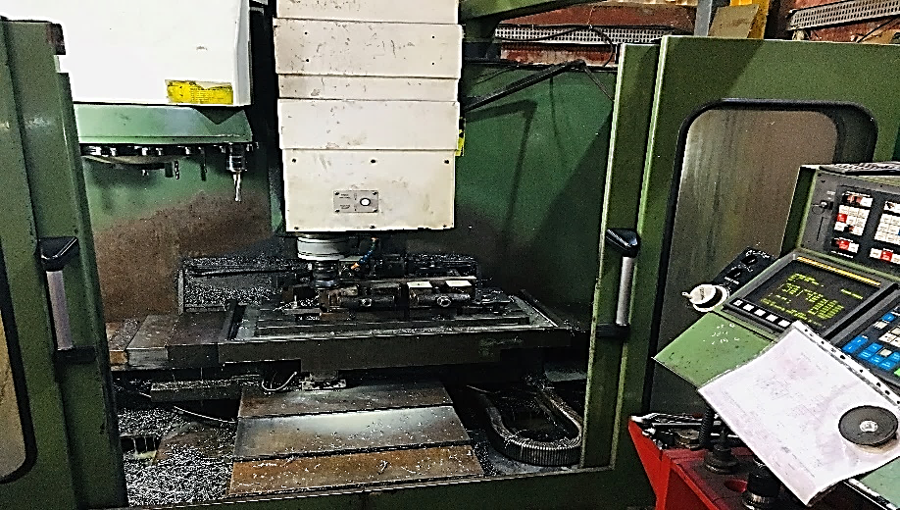
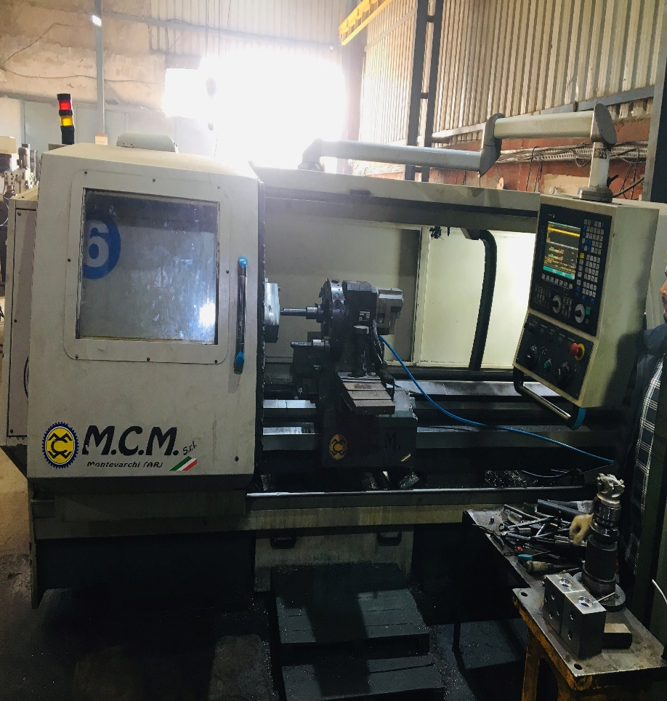
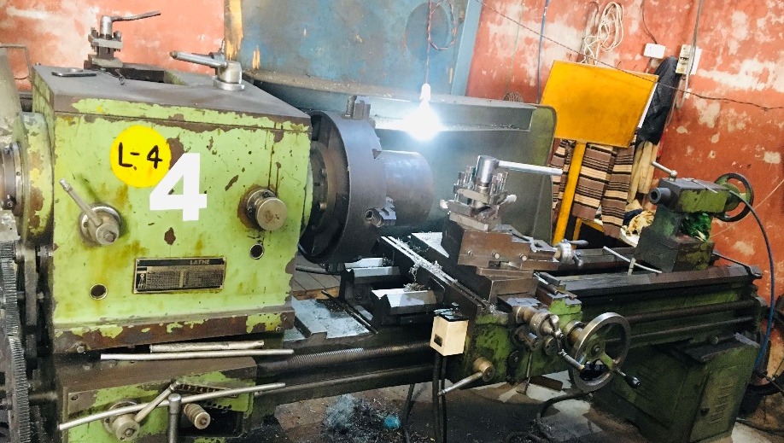
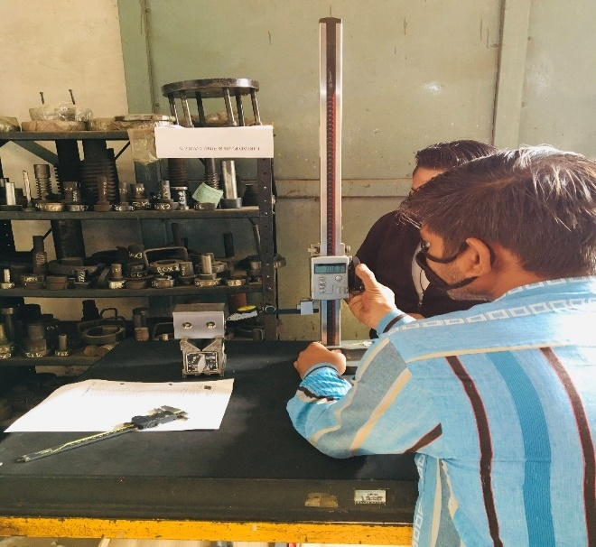
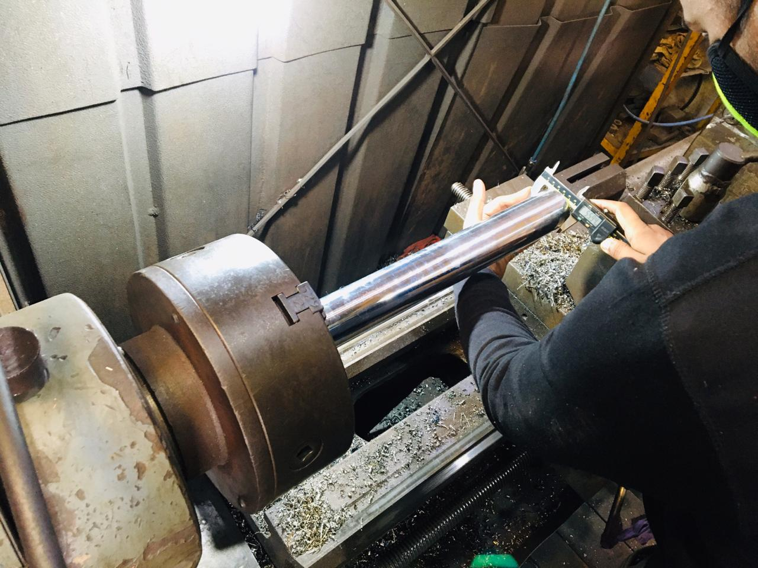
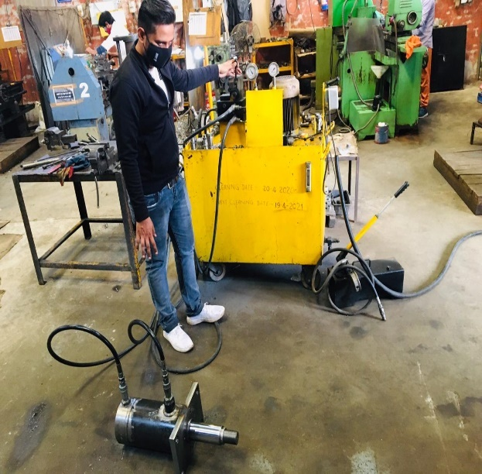
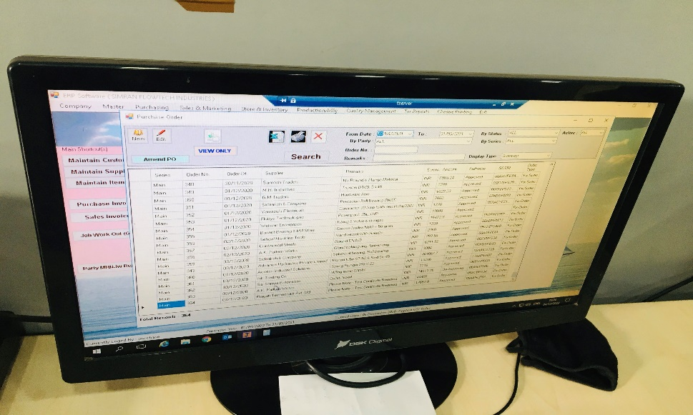
OVERVIEW OF MANUFACTURING FACILITIES
Design Stations
VMC Machine
CNC Machine
M1TR Machine
Mig Welding
Grinders
Lathe Machine
Power Back-up
Cylinder Pressure Testing
ERP Software
Standard Room
Inspection

Slide 16
SOME OF OUR
MAJOR ACHIEVEMENTS

Slide 17
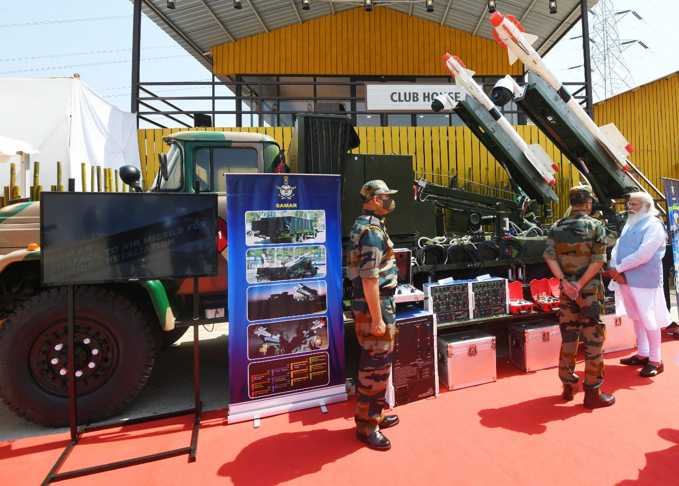
DEVELOPMENT OF LAUNCHER FOR SAMAR PROJECT
FOR
INDIAN AIR FORCE, BEING APPRECIATED BY HON’BLE PRIME MINISTER
SH. NARENDRA MODI JI

Slide 18
MAJOR DEFENCE PROJECTS
SAMAR-1 AIR DEFENCE SYSTEM
SAMAR-2 AIR DEFENCE SYSTEM
IR COOLING HEAD CAPABILITY ENHANCEMENT

Slide 19
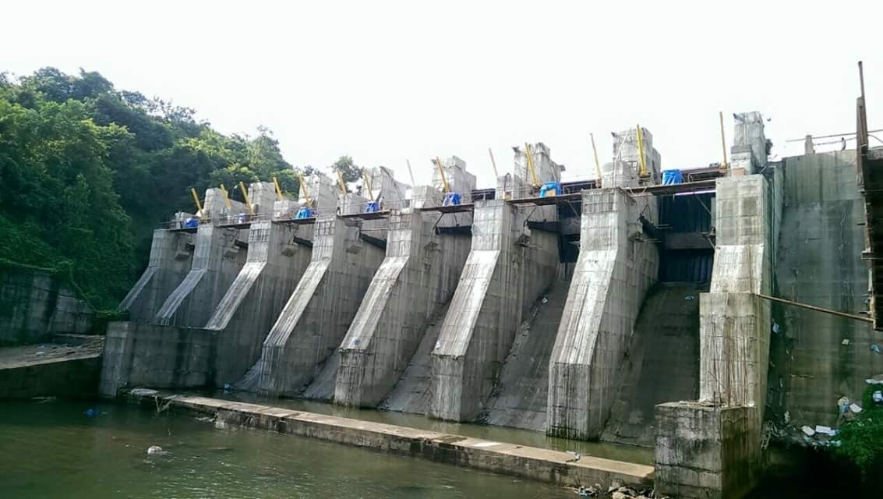
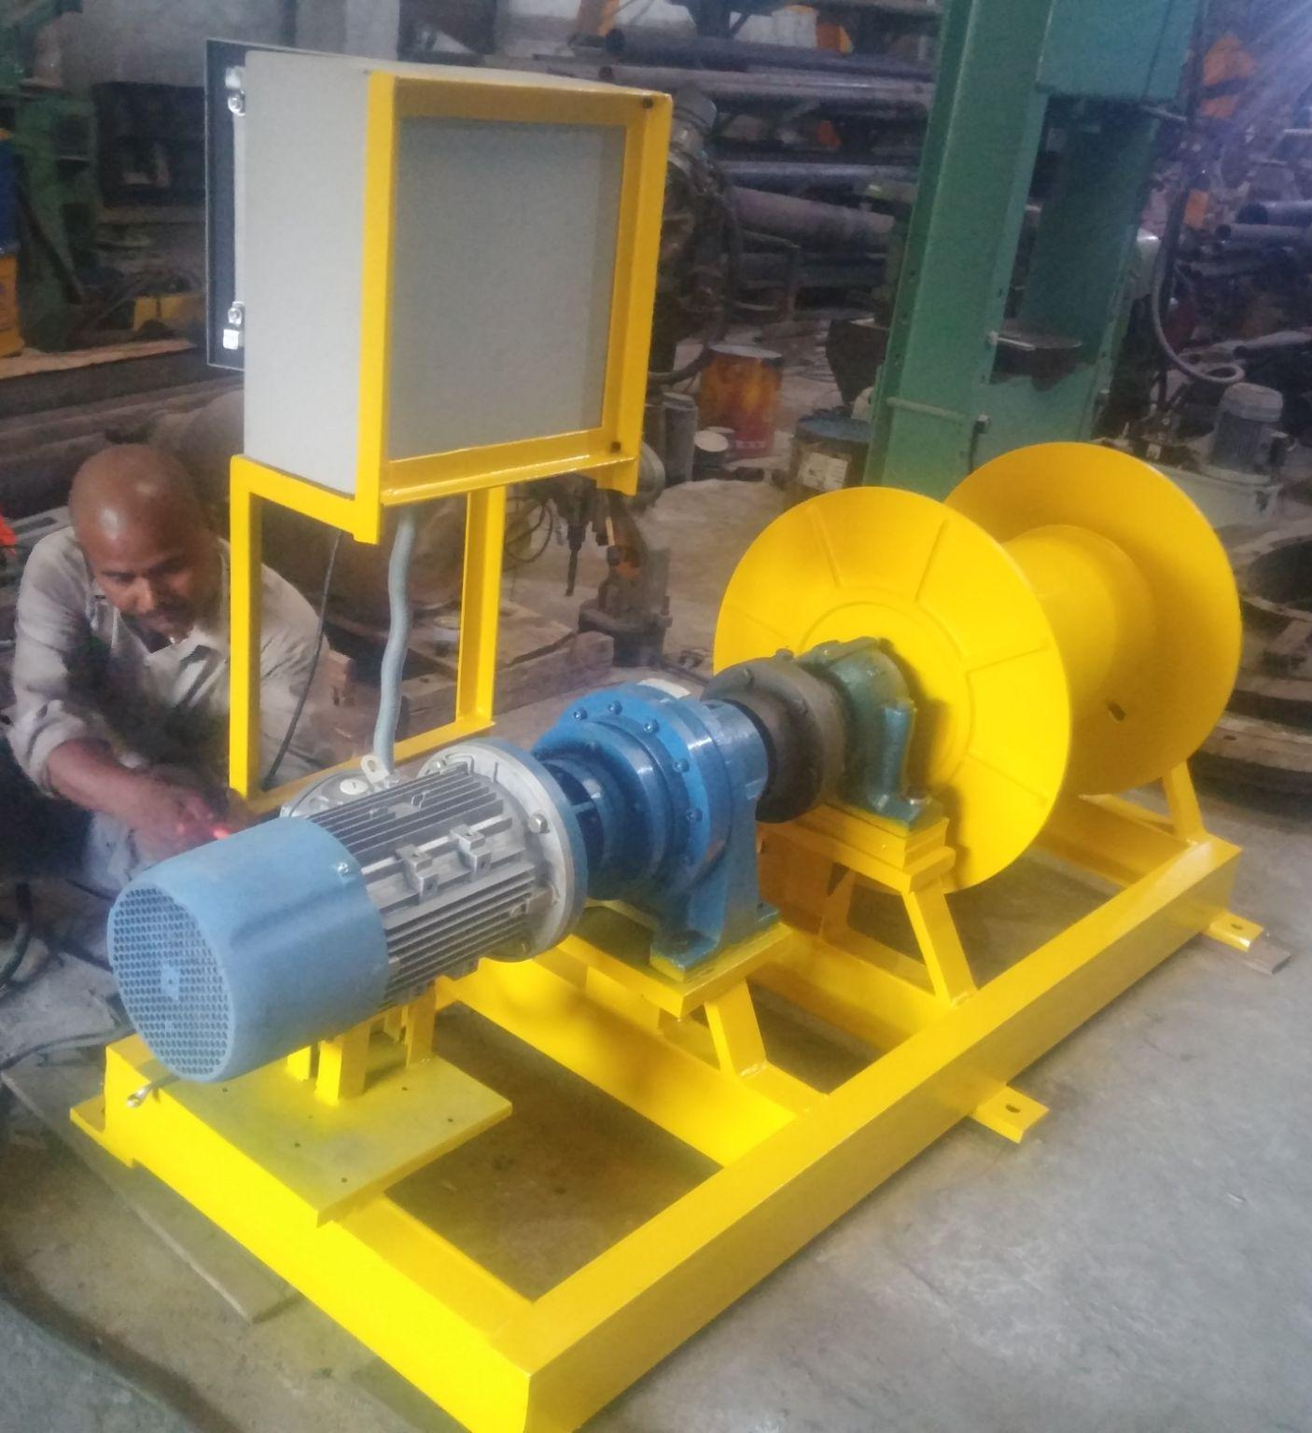
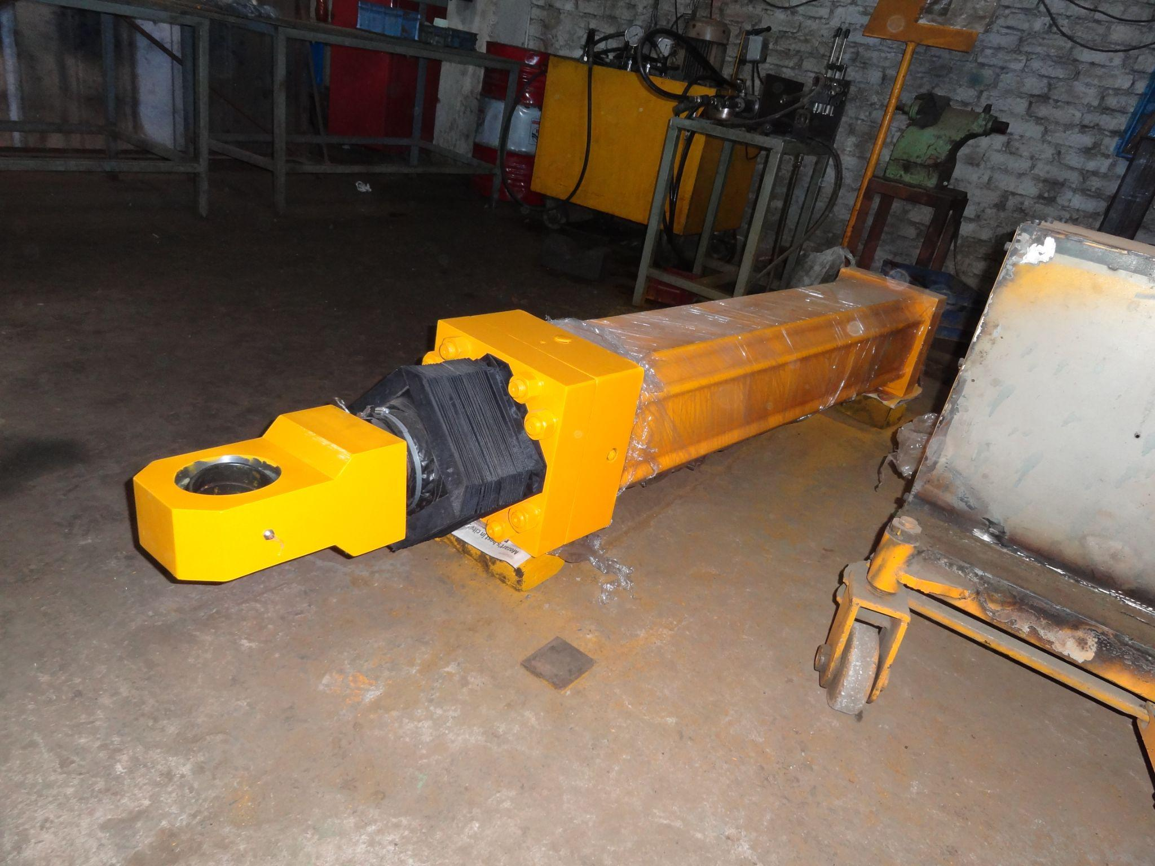
EQUIPMENT FOR HYDRO POWER PROJECTS
DAM GATE MECHANISM IN KARIYAM
FRANCIS RUNNER
OIL HEAD MECHANISM
WINCH FOR ROPEWAY MECHANISM
LARGE SIZE CYLINDERS

Slide 20
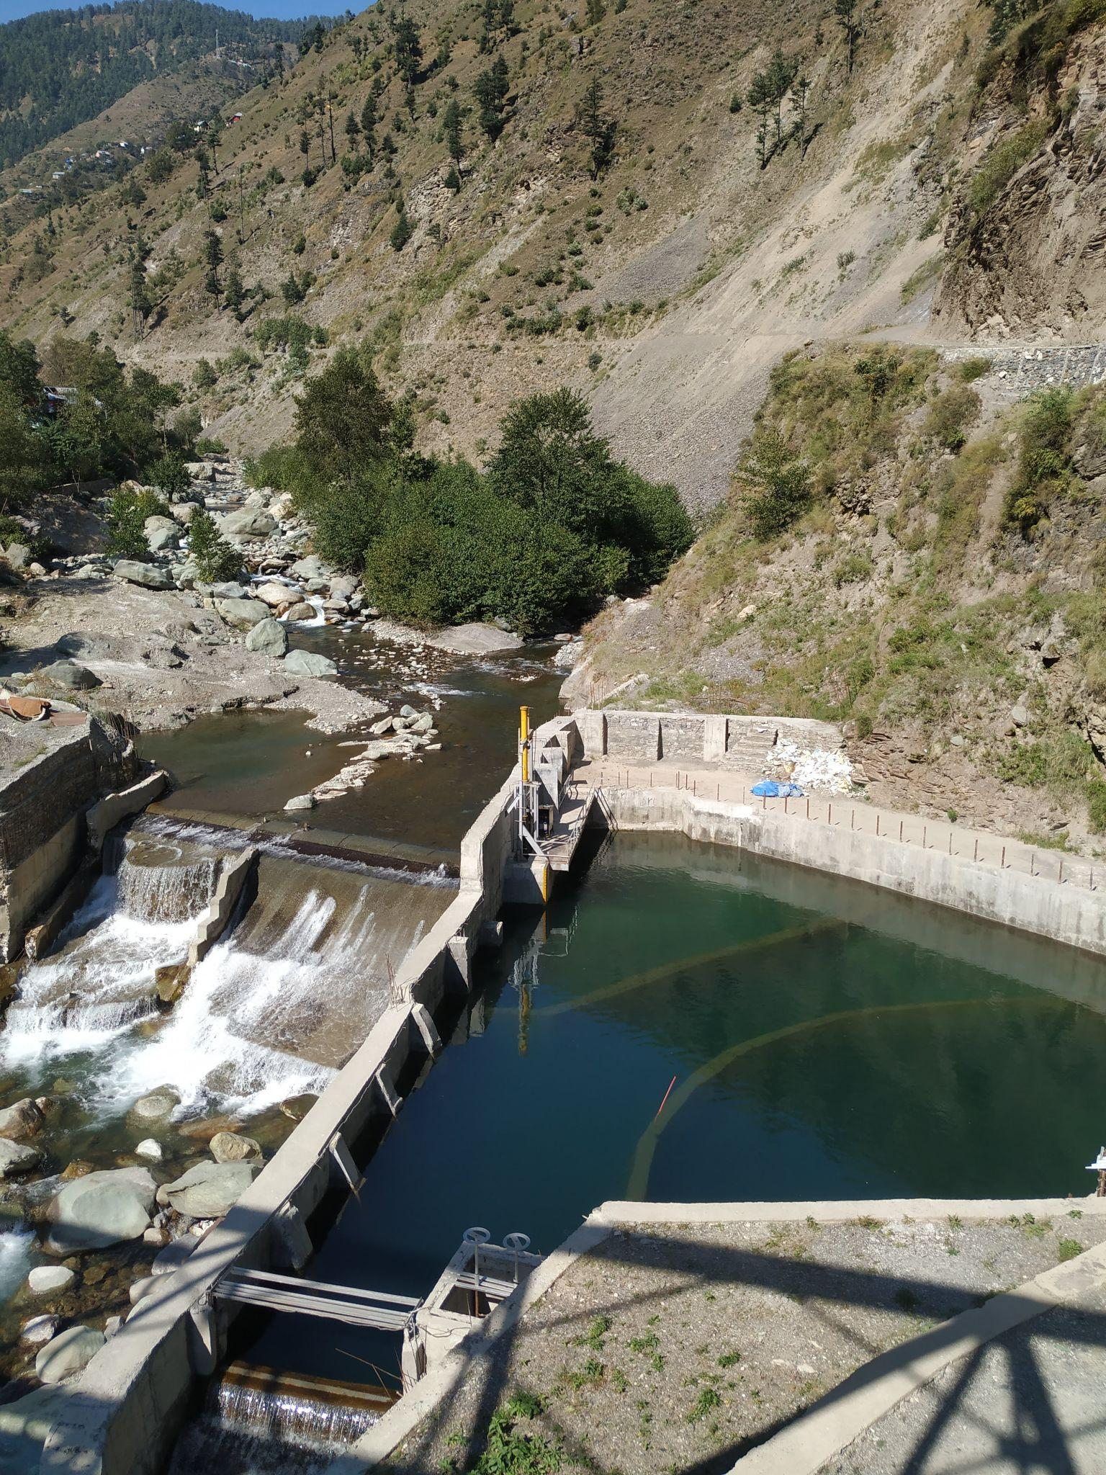
Hydraulic Systems Manufactured for Hydro-Power Plants

Slide 21
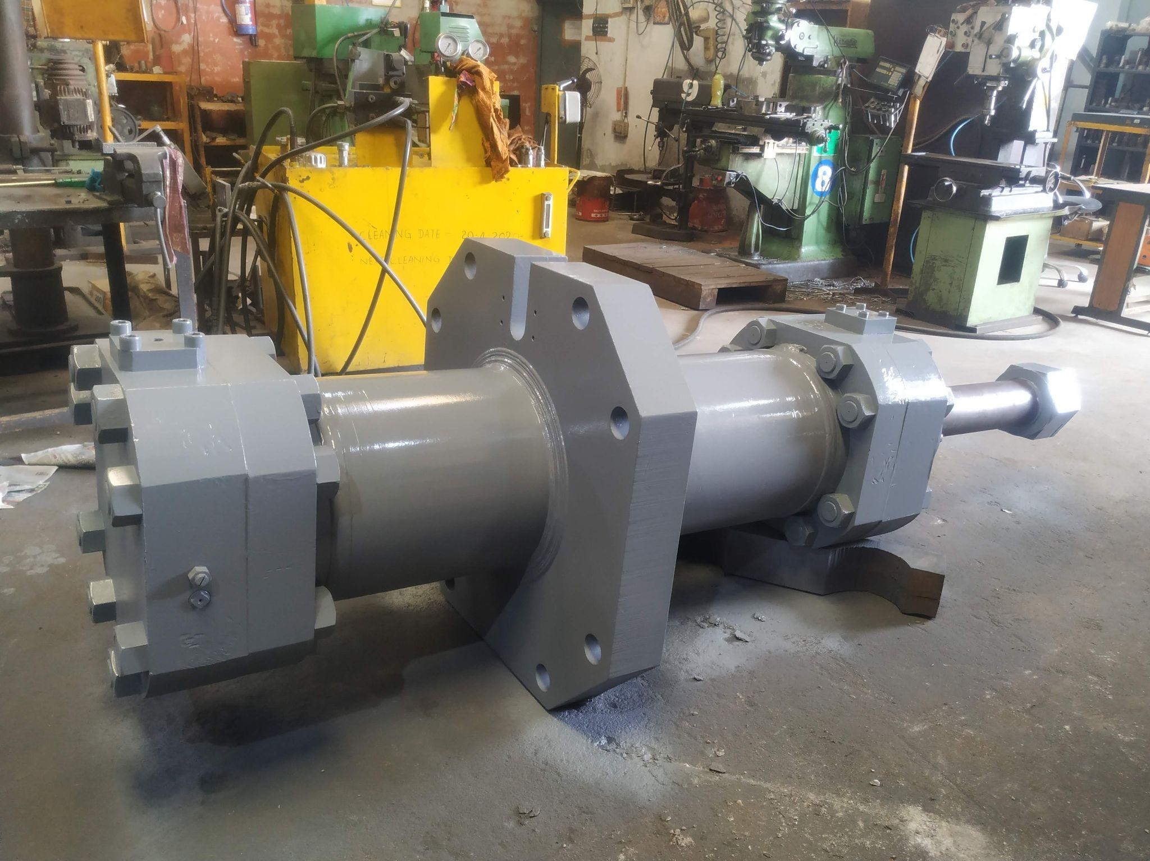
ROLL FORCE AND AGC CYLINDERS FOR STEEL ROLLING MILL INDUSTRY
FOR DIAMETER UP TO 800 MM

Slide 22
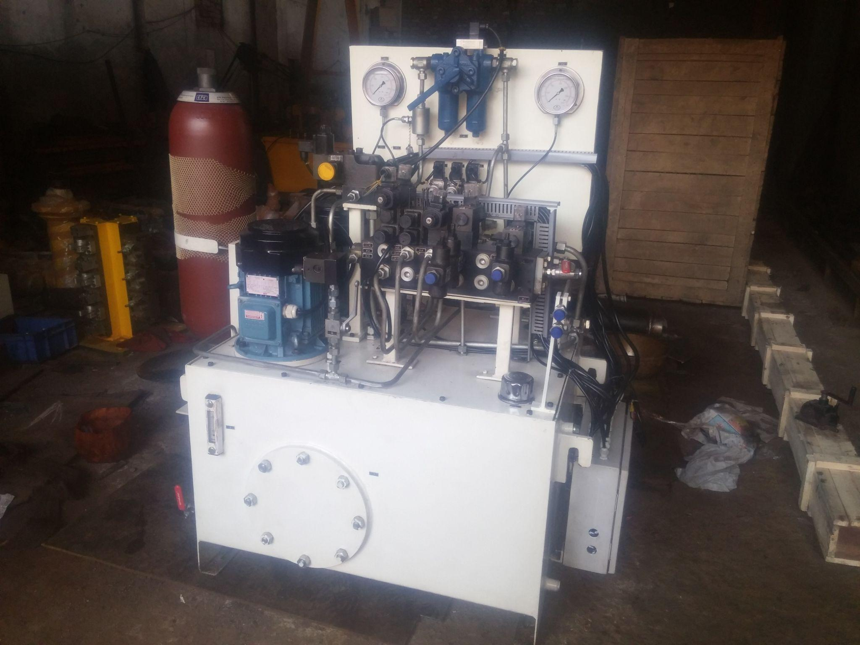
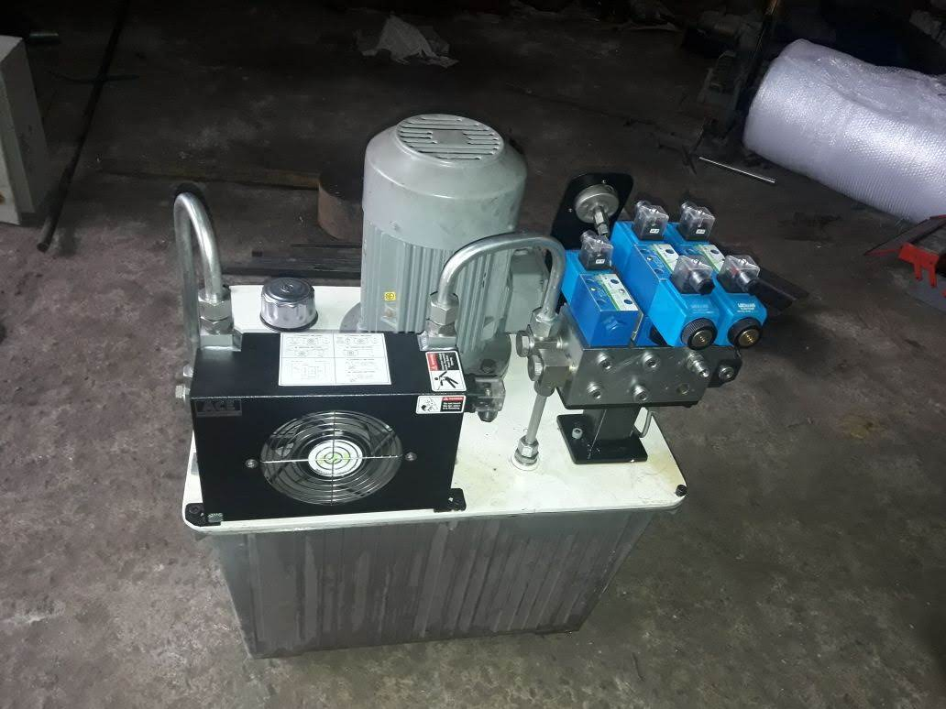
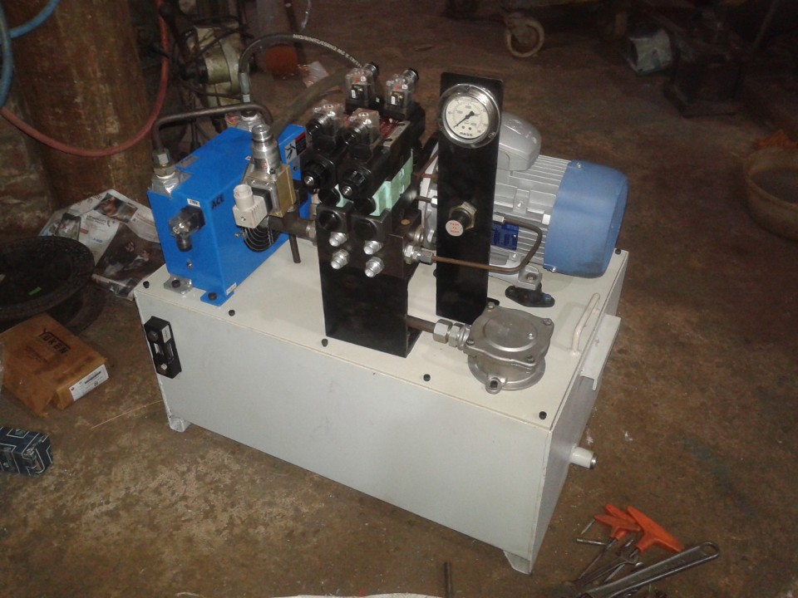
HYDRAULIC SYSTEMS & POWER PACKS

Slide 23
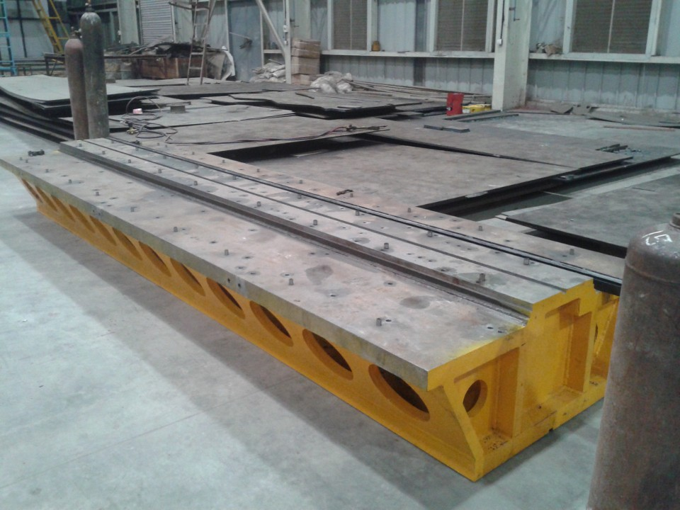
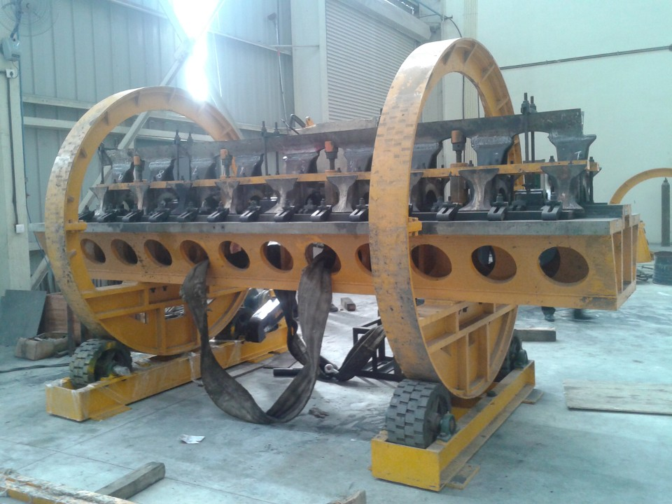
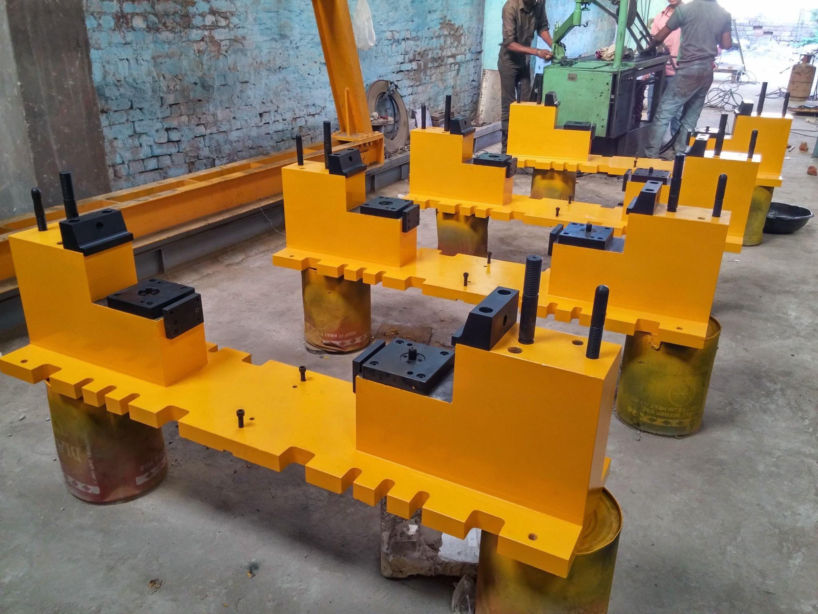
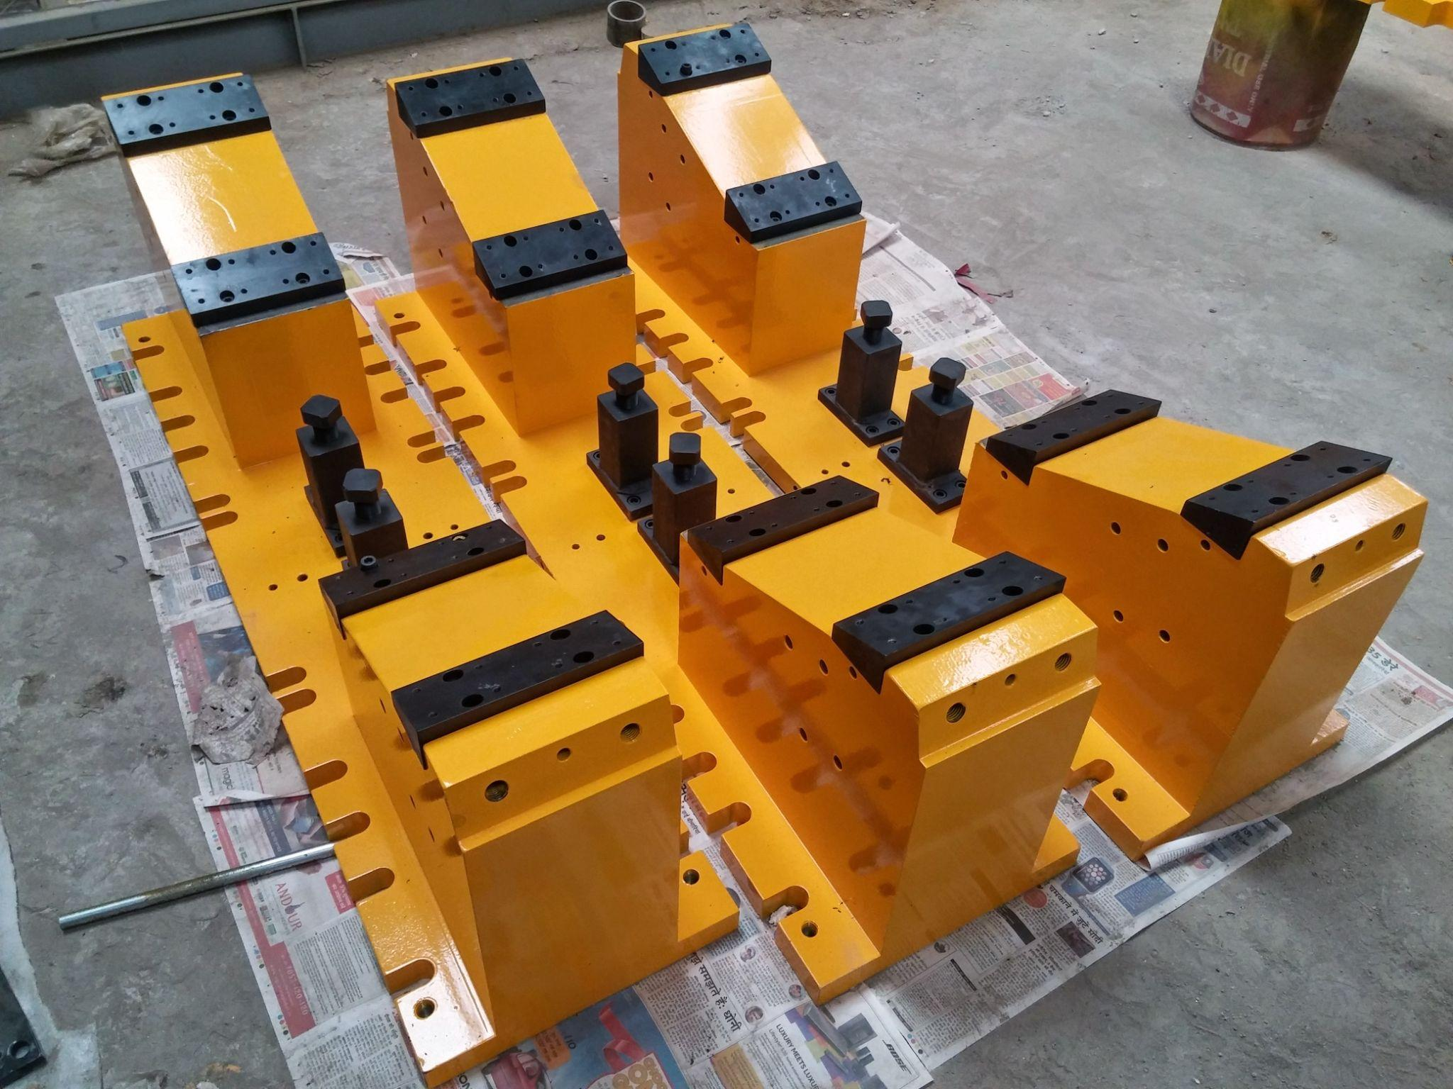
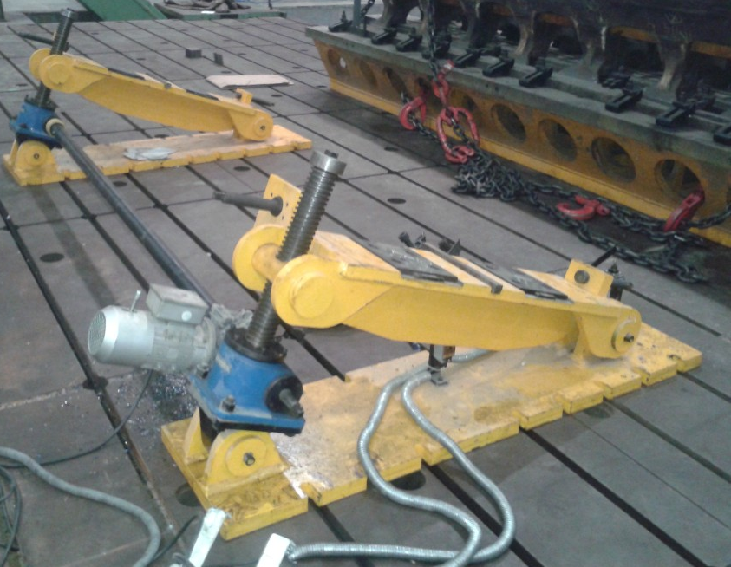
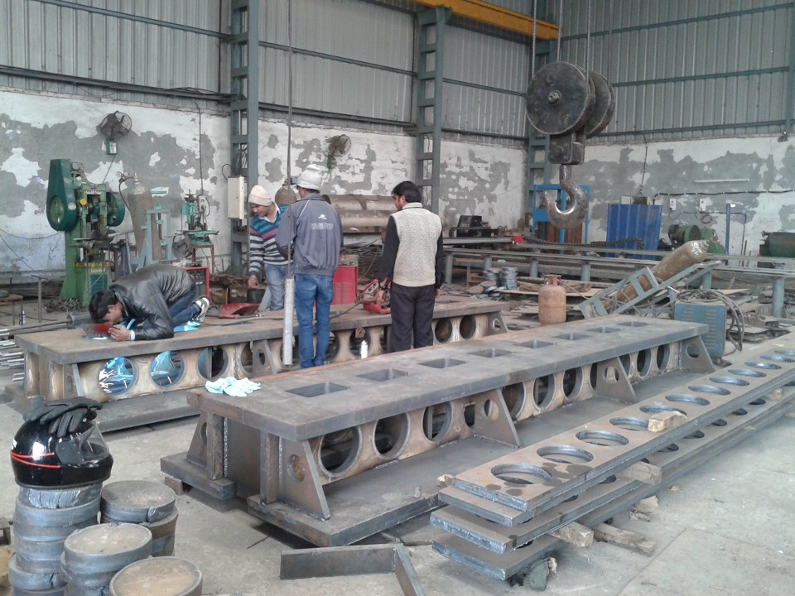
RAILWAY EQUIPMENT

Slide 24
MATERIAL HANDLING EQUIPMENT

Slide 25
AUTOMATIC TRANSFER TROLLEYS

Slide 26
GOODS AND PASSENGER LIFTS
DESIGNED AND EXECUTED MANY GOOD AND PASSENGER LIFTS PROJECTS

Slide 27
STRUCTURAL PROJECTS UNDERTAKEN
SPECTATORS STAND AT F1 RACING TRACK

Slide 28
PRODUCT GALLERY

Slide 29
PRODUCT GALLERY

Slide 30
CONTACT DETAILS
Mobile: 9289733301
Website : www.simranflowtech.com
Email : simranflowtech@hotmail.com, info@simranflowtech.com, sales@simranflowtech.com

Slide 31
THANK YOU

